Slide 1
Economic Decision Making

Slide 2
Cash Flows
Cash flows are the net amount of cash and cash-equivalents being transferred into and out of a business. Cash received are inflows, and money spent are outflows.
Cash flows refer to the movements of money into and out of a business, typically categorized as cash flows from operations, investing, and financing.
Positive cash flow indicates that a company's liquid assets are increasing, enabling it to cover obligations reinvest in its business, return money to shareholders, pay expenses, and provide a buffer against future financial challenges. Companies with strong financial flexibility can take advantage of profitable investments. They also fare better in downturns, by avoiding the costs of financial distress.
Cash flows can be analyzed using the cash flow statement, a standard financial statement that reports on a company's sources and usage of cash over a specified time period. The cash flow statement can be used to understand the trends of a company's performance that can't be understood through the other financial statements like the balance sheet or income statement on their own.

Slide 3
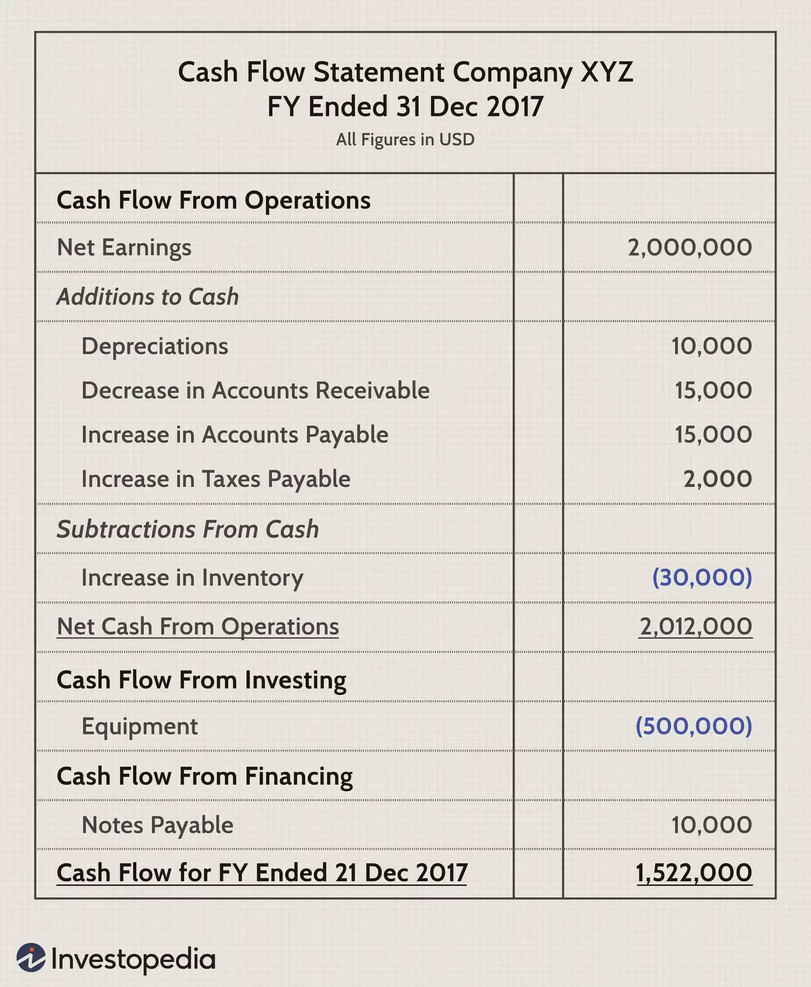
Cash Flow Categories
Cash Flows from Operations (CFO)
Cash Flows from Investing (CFI)
Cash Flows from Financing (CFF)

Slide 4
Statement of Cash Flows
There are three critical parts of a company's financial statements:
The balance sheet: It gives a one-time snapshot of a company's assets and liabilities.
The income statement: It indicates the business's profitability during a certain period.
The cash flow statement: It shows the company's cash transactions (the inflows and outflows) during the given period. It shows whether all of the revenues booked on the income statement have been collected.

Slide 5
Free Cash Flow
To understand the true profitability of the business, analysts look at free cash flow. It is a really useful measure of financial performance – that tells a better story than net income — because it shows what money the company has left over to expand the business or return to shareholders, after paying dividends, buying back stock, or paying off debt.
Free Cash Flow = CFO- CFI

Slide 6
Rate of Return Analysis
A rate of return (RoR) is the net gain or loss of an investment over a specified time period, expressed as a percentage of the investment’s initial cost. When calculating the rate of return, you are determining the percentage change from the beginning of the period until the end.
Rate of return=[(Current value−Initial value) /Initial value]×100
F = P (1 + i)^{N}
^{F= Final Return}
^{P= Initial Investment}
^{N= Number of Years}
^{i= Rate of Return}
^{F/P = (1+i)^N}
^{Taking log both the sides}
^{Log(f/P)=NLog(1+i)}
^{1/Nlog(F/p) = log(1+i)}
^{e^(1/N log(f/P) -1 = i}

Slide 7
Time Value of Money
Absolute Value of Money Today is worth more than that exact value of money due to change in the inflation rate and supply of money.
The time value of money draws from the idea that rational investors prefer to receive money today rather than the same amount of money in the future because of money's potential to grow in value over a given period of time. For example, money deposited into a savings account earns a certain interest rate and is therefore said to be compounding in value.
Time Value of Money Formula: FV = PV x [ 1 + (i / n) ] ^(n x t)
FV = Future value of money
PV = Present value of money
i = interest rate
n = number of compounding periods per year
t = number of years

Slide 8
Pay - back period
The payback period refers to the amount of time it takes to recover the cost of an investment.
PBP = Cost of Investment / Annual Cash Flows
PBP = 5,00,000/1,00,000
PBP = 5 Years

Slide 9
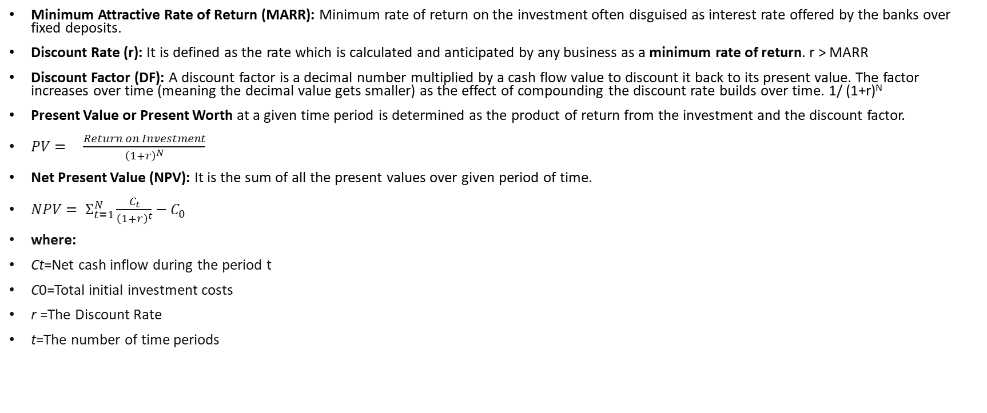
Net Present Value
Minimum Attractive Rate of Return (MARR): Minimum rate of return on the investment often disguised as interest rate offered by the banks over fixed deposits.
Discount Rate (r): It is defined as the rate which is calculated and anticipated by any business as a minimum rate of return. r > MARR
Discount Factor (DF): A discount factor is a decimal number multiplied by a cash flow value to discount it back to its present value. The factor increases over time (meaning the decimal value gets smaller) as the effect of compounding the discount rate builds over time. 1/ (1+r)^{N}
Present Value or Present Worth at a given time period is determined as the product of return from the investment and the discount factor.
${PV= }_{}^{}\frac{Return on Investment}{{\left(1+r\right)}^{N}}$
Net Present Value (NPV): It is the sum of all the present values over given period of time.
${NPV= Σ}_{t=1}^{N}\frac{C_{t}}{{\left(1+r\right)}^{t}}−C_{0 }$
where:
Ct​=Net cash inflow during the period t
C0​=Total initial investment costs
r =The Discount Rate
t=The number of time periods​

Slide 10

Example1: Calculating NPV
A sum of Rs 4,00,000 invested today in an IT project may give a series of below cash inflows in future:
Rs 70,000 in year 1
Rs 120,000 in year 2
Rs 140,000 in year 3
Rs 140,000 in year 4
Rs 40,000 in year 5
If rate of return on capital is 8% per annum, then should we accept or reject the project?
Solution:
Step 1: Calculate the PV value of year 1, year2, year3, year4, and year5
Step 2: Sum up the PV of all years
Step3: NPV = Present value of all cash inflows – Present value of all cash outflow.
Step 4: If NPV is positive, Accept the project, if not Reject the project.

Slide 11

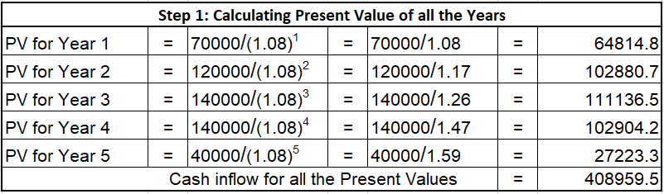
Cash Inflow of all Present Values is : Rs 408,959
Present value of Cash outflow is : Rs 400,000
Net Present Value 🡺 PV of Cash inflows – PV of Cash Outflows 🡺 (Rs 408959 – Rs 400000) = Rs8959.
Since NPV is positive, (i.e., Rs 8959, This project can be accepted)

Slide 12
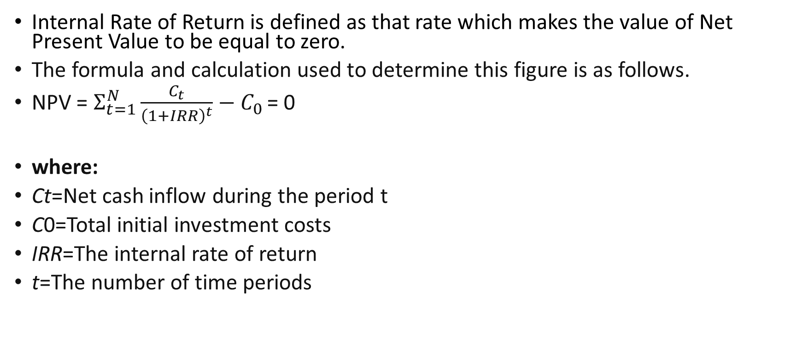
Internal Rate of Return (IRR)
Internal Rate of Return is defined as that rate which makes the value of Net Present Value to be equal to zero.
The formula and calculation used to determine this figure is as follows.
NPV = $Σ_{t=1}^{N}\frac{C_{t}}{{\left(1+IRR\right)}^{t}}−C_{0 }$= 0
​
where:
Ct​=Net cash inflow during the period t
C0​=Total initial investment costs
IRR=The internal rate of return
t=The number of time periods​

Slide 13
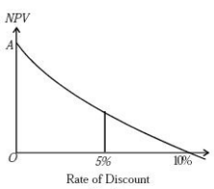
Relation Between NPV & IRR
As NPV falls, the discount rate increases and a situation arises when NPV becomes negative. The rate at which NPV changes from positive to negative is the IRR. That project will be selected whose IRR is higher than its discount rate. So the right criterion for the choice of project is IRR > r. This is illustrated in Figure where IRR is taken as 10 per cent and the discount rate as 5 per cent in the case of project A.

